Slide 1
Secure Banking System using
Blockchain Technology
Capstone Project
Review -2
Team -25

Slide 2
Project Title : Secure Banking System using Blockchain Technology
Guide : Dr Nitish Andola
Members :
18BCY10034 | Fardeen Ahmed
18BCY10010 | Akshat Nigam
18BCY10093 | Shreyansh Saxena
18BCY10012 | Alkesh Gupta

Slide 3
Proposed Work
We aim to develop a web-based serverless application which works on a decentralized system for handling transactions between users ruling out the utilization of any centralized database.
All the transactions are to be verified by smart contract and stored in the Near Blockchain. The application will be built on the top of a cloud-based infrastructure which will be a community-operated cloud instead of a company-operated cloud.
Appropriate additional level of security measures will be implemented for the user authentication before any transactions occurs.

Slide 4
Software Requirements
Frameworks
React
Material UI
NEAR Blockchain
Languages
JavaScript
HTML & CSS
AssemblyScript
IDE
VS Code

Slide 5
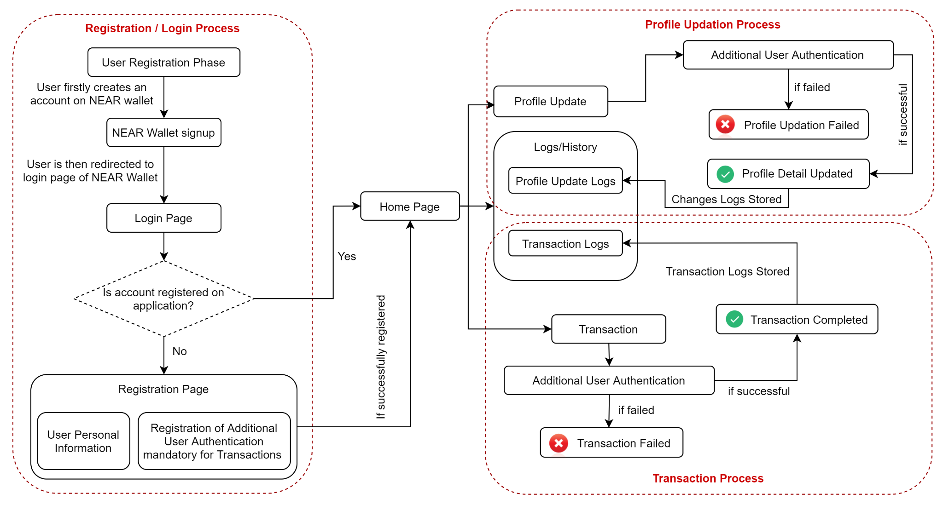
Overall System Architecture Diagram

Slide 6
Modules & Explanation
01. Authentication Module : User Registration & Login Process will be implemented under this module using NEAR wallet authentication.
02. Profile Details Module : Basic user details such as mobile, email, etc will be handled under this module.
03. Transaction Module : Money Transaction process between user accounts will be implemented.
04. Logs & History Module : Profile modification & transaction history will be managed under this module.
05. Additional Authentication Module : Second level authentication, for transaction purpose & profile updation, will be implemented in this module.

Slide 7
Work Completed Till Date
01. Registration of User Account.
01.1 Application Connection with NEAR Wallet.
01.2 User Account Creation on the Application.
02. Transaction Between Accounts.
02.1 Transferring NEAR Token from one Account to another.
02.1.1 Taking affirmative action from User through Passphrase.
02.2 Storing the transaction logs at both the User Ends.
03. Implemented Recent User’s Transactions History.

Slide 8
Anticipated Work To Be Done
01. User’s Complete Transactions and Login History
02. User’s Profile Updation
03. Money Transfer Request Feature
04. Money Transfer through QR
05. Device Responsive Design

Slide 9
THANK YOU

